Slide 1
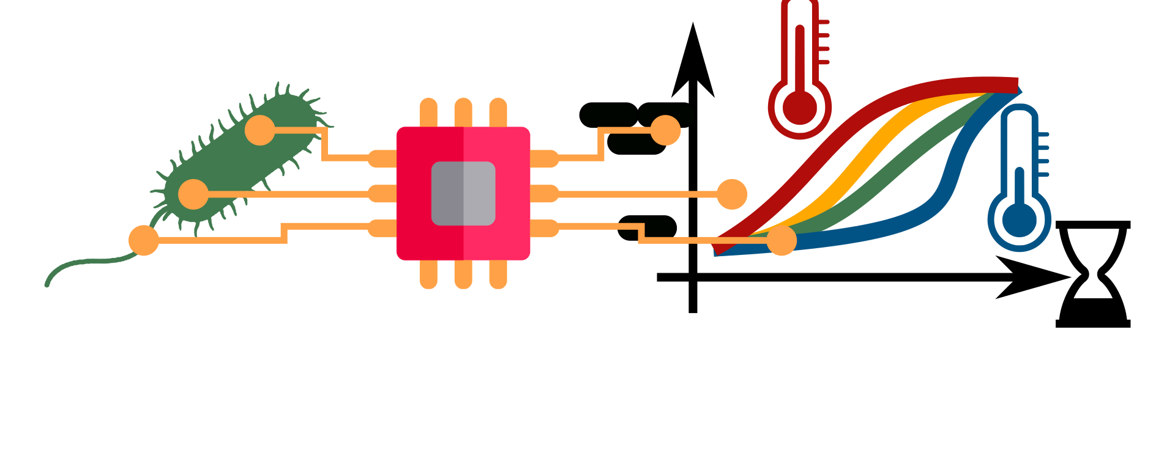
GenScaleSim: Simulation of Genome Scale Metabolic Models
The BioLabSim.nrw consortium

Slide 2
Outline
Genome-scale models
Introduction
Hands on tutorial
FBA with Jupyter Notebooks

Slide 3
Teaching Objectives
Calculation of molar- and rate-based yields.
Evaluation of realistic yields
Knowledge of tradeoff between product yield and growth rate
Analysis of the stoichiometric matrix in genome scale models.
Extracting dimension of metabolites and reactions
Knowledge of composition of exchange reactions

Slide 4
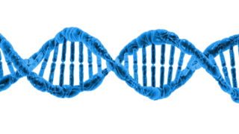


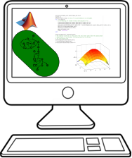
Modeling and Simulation in Biotechnology?
High throughput sequencing is rapid and cheap.
Genome sequencing catalogues a large part of the enzymatic composition of microorganisms.
File:Ácido desoxirribonucleico (DNA).png, https://commons.wikimedia.org/w/index.php?title=File:%C3%81cido_desoxirribonucleico_(DNA).png&oldid=674262631
New metabolic capacities are engineered by manipulating the enzymatic composition.
Experiments are overall time consuming and expensive and naive functions expectations can be misleading.
Computer based simulation of metabolism:
Identification of genetic modifications for efficient target substance production.
Rapid and cheap hypothesis cycles.
Highly reproducible and automatable.

Slide 5
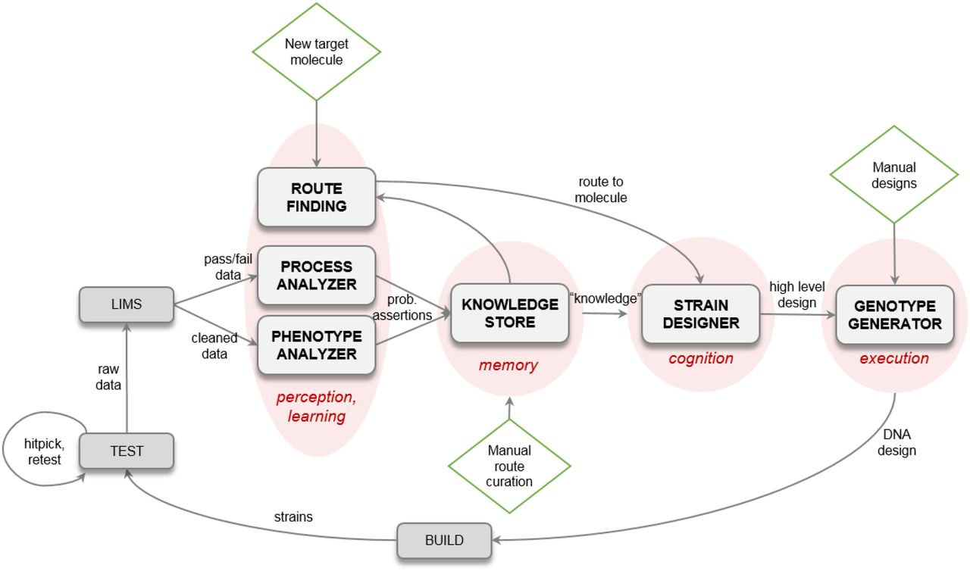
Example: Automated strain development by Amyris Inc.
Amyris is an innovative California-based biotech company (600 employees).
Strain development for market scale in tons of product requires many steps with dedicated experts.
Strain development is expensive ($100-$200 M) and time consuming (>10 years).
Construction of a automated workflow to design and test molecules and pathways for industrial upscaling.
Part of the automated workflow: metabolic flux prediction for effectiv genetic manipulation.
Singh et al., 2023. An Automated Scientist to Design and Optimize Microbial Strains for the Industrial Production of Small Molecules, bioRxiv, https://doi.org/10.1101/2023.01.03.521657

Slide 6
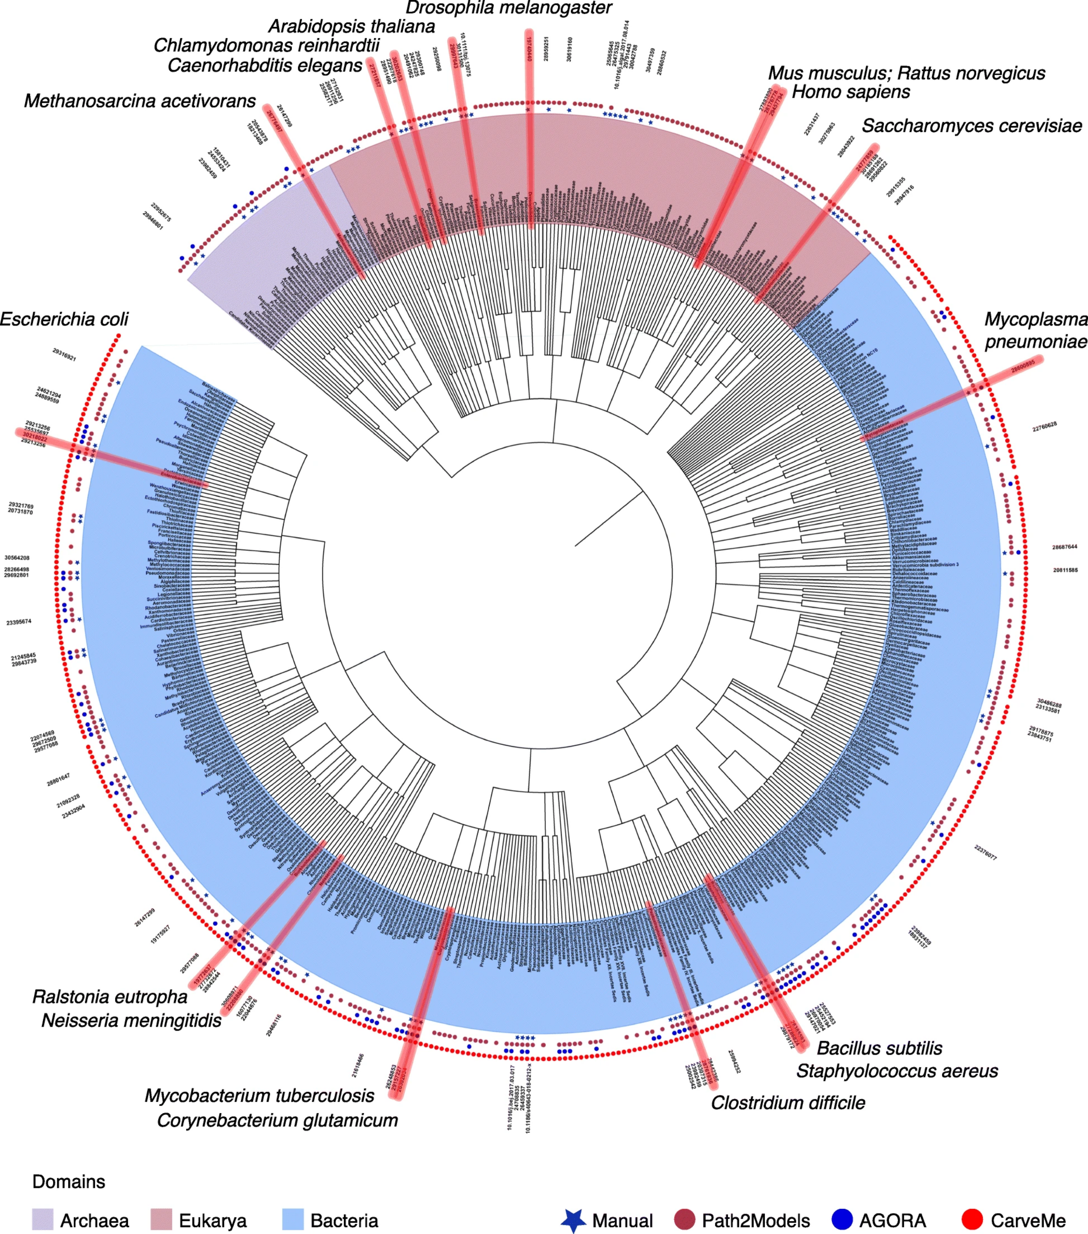
Genome-Scale Network Reconstructions: Available for many species
A GEnome scale Network Reconstructions (GENREs) structured knowledge base of biochemical facts
Genome scale metabolic models (GEM, GSMM) model which supplements the established biochemical information with additional (potentially hypothetical) information to enable computational simulation and analysis.
183 manually curated species
across the tree of life
Gu et al., 2019. Current status and applications of genome-scale metabolic models. BMC Gen Bio
https://doi.org/10.1186/s13059-019-1730-3

Slide 7
Examples of Highly Curated Models
Helicobacter pylori:
iIT341
485 metabolites
554 reactions
339 genes
(21% of predicted genes)
Escherichia coli: iML1515
1877 metabolites
2712 reactions
1515 genes
(35% of predicted genes)
Pseudomonas putida KT2440
iJN746
907 metabolites
1054 reactions
746 genes
(14% of predicted genes)
S. cerevisiae: yeastGEM
2691 metabolites
3963 reactions
1139 genes
Mus musculus: iMM1415
2775 metabolites
3726 reactions
1375 genes
Homo Sapiens
Recon3D
4140 unique metabolites
13543 reactions
3288 genes
(17% of functionally annotated human genes)
Repositories: BiGG database: http://bigg.ucsd.edu
EMBL-EBI Biomodels DB: https://www.ebi.ac.uk/biomodels-main/

Slide 8
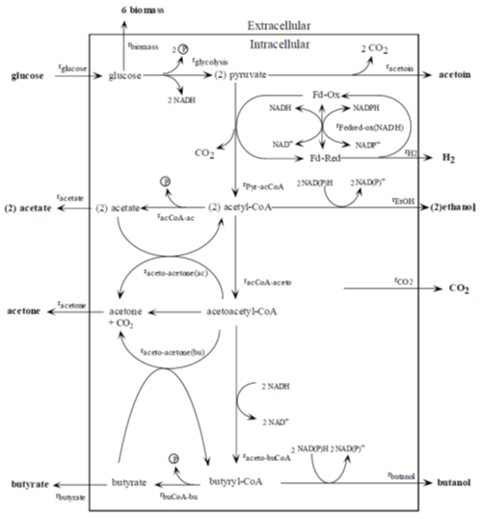
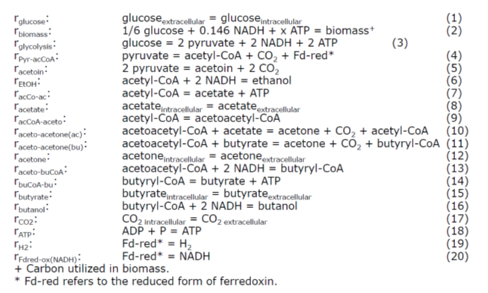
Small Scale Models
Each metabolic reaction is listed, e.g. from a sequence annotation.
For organisms without sequence annotation models of central carbon metabolism and biomass can provide good metabolic approximations.

Slide 9
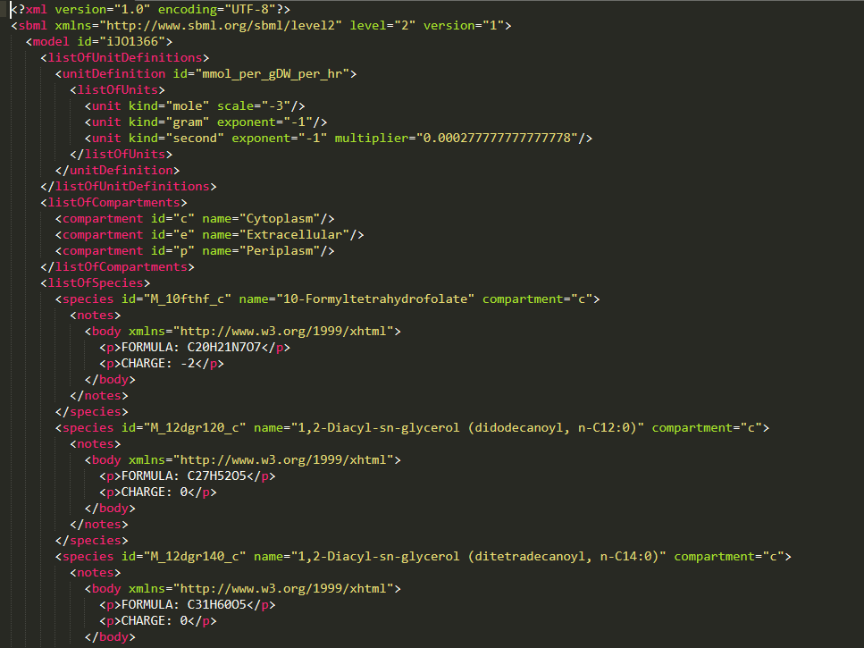
Common model format: SBML Systems Biology Mark-up Language
Metabolic models are stored following conventions of the Systems Biology Mark-up language (SBML).
SBML-files are designed for efficient machine readability and are compatible with most modeling tools.
SBML-files end with .xml.

Slide 10
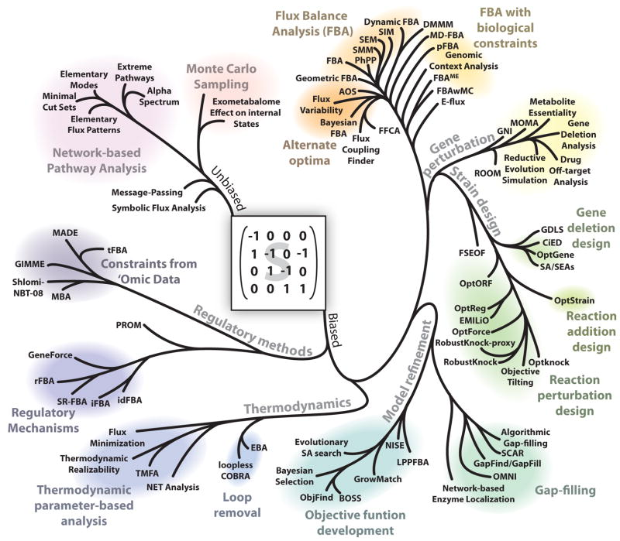
Various Methods allow for Analysis of GSMM
Genome scale metabolic models consist of the stoichiometric reaction matrix.
#reactions > #metabolites: reaction fluxes cannot be solved directly
Different methods investigate properties of the stoichiometric matrix, most relevant for biotechnology:
Flux balance analysis (FBA)
Gap filling
Gene deletion/reaction addition
Lewis N et al. 2012. Constraining the metabolic genotype–phenotype relationship using a phylogeny of in silico methods. Nat Rev Microbiol.
https://doi.org/10.1038/nrmicro2737

Slide 11

Most Popular Program for Model Analysis: COBRApy
COBRA: COnstraint-Based Reconstruction and Analysis
py: Python
Python – general-purpose programming language; emphasizes code readability with clear, easy syntax (→ easy to learn),open-source
In COBRApy models are defined as a set of classes
Classes (object-oriented programming): extensible program-code-template for creating objects, providing initial values for state (member variables) and implementations of behavior (member functions or methods).
Image source: https://opencobra.github.io/cobrapy/

Slide 12
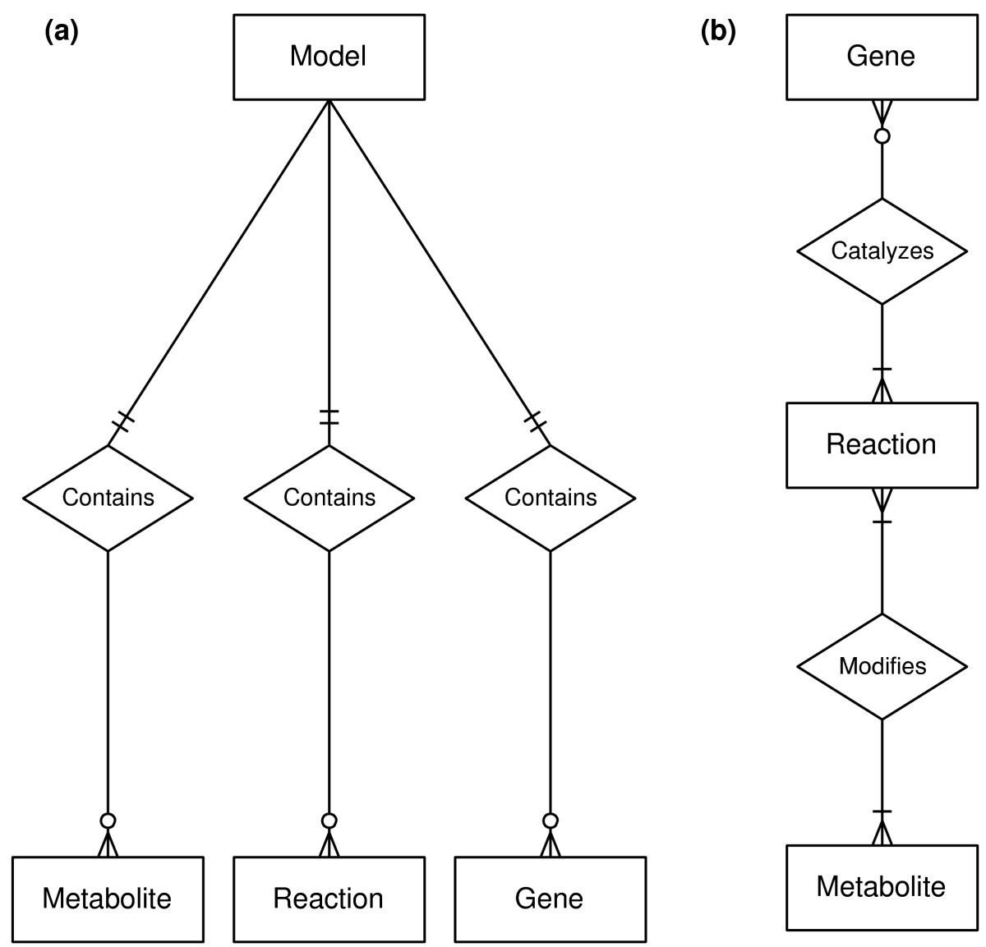
Entity Relationship Diagrams for Core-Classes in COBRApy
A Model contains Metabolites, Reactions, and Genes.
A Reaction may be catalyzed by 0 or more Genes. Reactions catalyzed by 0 Genes are spontaneous. A Reaction may be catalyzed by different sets of Genes. Reactions modify 1 or more Metabolites. A reaction that modifies only 1 metabolite is an external boundary condition. A Metabolite may be modified by many different Reactions.

Slide 13
How to Work with COBRApy Models?
model.metabolites.nadh_c.summary()
Get a summary of the entity 'nadh_c' from the subclass 'metabolites' in the class 'model' by calling the method 'summary()'
solution = model.optimize()
Optimize (run an FBA) on the model

Slide 14
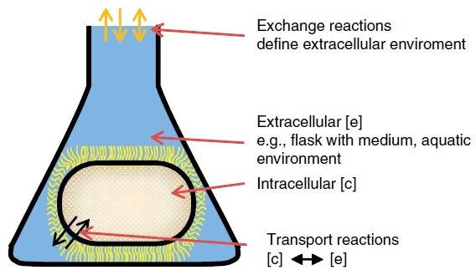
Model Compartments
Compartments of E. coli Model iJO1366:
e extracellular
c cytosol
p periplasma
Definition of exchange reactions: metab_e <=>
Phosphate exchange: pi_e <=>
Phosphate transport via diffusion (extracellular to periplasm)
pi_e <=> pi_p
Phosphate transport via ABC system (uptake, periplasm)
atp_c + h2o_c + pi_p -> h_c + adp_c + 2 pi_c

Slide 15
The Biomass Synthesis Reaction
Reaction fluxes cannot be solved uniquely because #reactions > #metabolites.
Finding the maximum value for one reaction: biomass synthesis reaction (objective function).
Each metabolite relevant for biomass is included in the biomass reaction.
Depending on the research/engineering question, alternative objective functions tested: ATP turnover, metabolite production...
0.000223 10fthf[c] + 0.000223 2ohph[c] + 0.5137 ala-L[c] + 0.000223 amet[c] + 0.2958 arg-L[c] + 0.2411 asn-L[c] + 0.2411 asp-L[c] + 59.984 atp[c] + 0.004737 ca2[c] + 0.004737 cl[c] + 0.000576 coa[c] + 0.003158 cobalt2[c] + 0.1335 ctp[c] + 0.003158 cu2[c] + 0.09158 cys-L[c] + 0.02617 datp[c] + 0.02702 dctp[c] + 0.02702 dgtp[c] + 0.02617 dttp[c] + 0.000223 fad[c] + 0.007106 fe2[c] + 0.007106 fe3[c] + 0.2632 gln-L[c] + 0.2632 glu-L[c] + 0.6126 gly[c] + 0.2151 gtp[c] + 54.462 h2o[c] + 0.09474 his-L[c] + 0.2905 ile-L[c] + 0.1776 k[c] + 0.01945 kdo2lipid4[e] + 0.4505 leu-L[c] + 0.3432 lys-L[c] + 0.1537 met-L[c] + 0.007895 mg2[c] + 0.000223 mlthf[c] + 0.003158 mn2[c] + 0.003158 mobd[c] + 0.01389 murein5px4p[p] + 0.001831 nad[c] + 0.000447 nadp[c] + 0.011843 nh4[c] + 0.02233 pe160[c] + 0.04148 pe160[p] + 0.02632 pe161[c] + 0.04889 pe161[p] + 0.1759 phe-L[c] + 0.000223 pheme[c] + 0.2211 pro-L[c] + 0.000223 pydx5p[c] + 0.000223 ribflv[c] + 0.2158 ser-L[c] + 0.000223 sheme[c] + 0.003948 so4[c] + 0.000223 thf[c] + 0.000223 thmpp[c] + 0.2537 thr-L[c] + 0.05684 trp-L[c] + 0.1379 tyr-L[c] + 5.5e-005 udcpdp[c] + 0.1441 utp[c] + 0.4232 val-L[c] + 0.003158 zn2[c] → 59.81 adp[c] + 59.81 h[c] + 59.806 pi[c] + 0.7739 ppi[c]

Slide 16
Promoter Activity Prediction with Random Forest
Genome-scale models
Introduction
Hands on tutorial
FBA with Jupyter Notebooks

Slide 17

Authors and License
BioLabSim.nrw members at:
https://git.rwth-aachen.de/ulf.liebal/biolabsim/-/blob/master/AUTHORS.md
Main authors: Dr. Ulf Liebal, Prof. Dr. Lars Blank
The construction of slides was supported by Dr. Birgitta Ebert.
All material in this lecture is free to use, adapt and distribute according to CC BY 4.0 citing:
Ulf Liebal, BioLabSim.nrw consortium, GenScaleSim Lecture, 2023, https://git.rwth-aachen.de/ulf.liebal/biolabsim

